Slide 1

Al rajhi
Bank
WELCOME TO THE
Presentation

Slide 2

Introduction
Banks are considered as a vitally important service in our everyday life. They help us access our funds through personal services and self-service medium such as online banking apps.

Slide 3


Problems
As banks sometimes may not provide a sufficient number of branches in each city, online banking services play an essential role in bridging the gap between the customer and the bank.

Slide 4

Background
4.750
Al-Rajhi bank is one of the world’s largest Islamic banks with total assets of 741 billion SR. and it has a large network of over 557 branches and more than
ATM machines across Saudi Arabia.

Slide 5
Proposed solutions
Al-Rajhi app enables customers to have a customized personal banking experience and to manage all their banking operations at anytime from anywhere remotely. Additionally, it provides customers with credit cards that help them to pay for any kind of services saving them the effort to withdraw money from ATM machines.

Slide 6
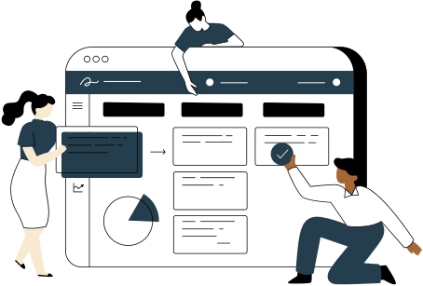
Work Plan
One of the major issues that persists is the lack of Al-Rajhi, which could be solved by establishing an application that enables customers to use the bank services

Slide 7

Functional requirement
System requirements:
1- The system must allow the user to log in using password and phone number or ID.
2- the system must provide an icon “forgot password” in case the user forgot their password.
3- the system must provide an option “remember me” to save user’s login information.
4- the system shall allow the user to open a new account for the customers who don’t have an account .
5- the system shall allow the user to register digital channels for the customers who opened an account through the branch.
6- the system shall send a verification code to authenticate the user.
7- the system shall send messages of debit and credit operations.
8- the system must provide quick access option by using a MPIN chosen by customers.
9- the system must make a call to the customer’s phone number to allow them to add beneficiaries by pressing a specific number.
10- the system must allow the user to view history of transactions .

Slide 8
Non-Functional requirement
1- The system must automatically log the customer out of their account when it’s inactive after 5 minutes.
2- the system must send the verification code within 1 minute.
3- customers shall be prompted to provide ATM card number and the username to create new password.
4- Each page must load within 2 seconds.

Slide 9
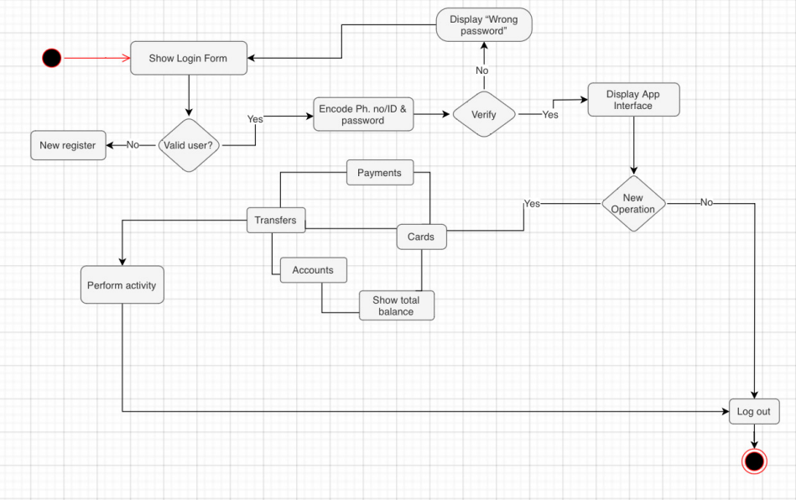
Activity diagram

Slide 10
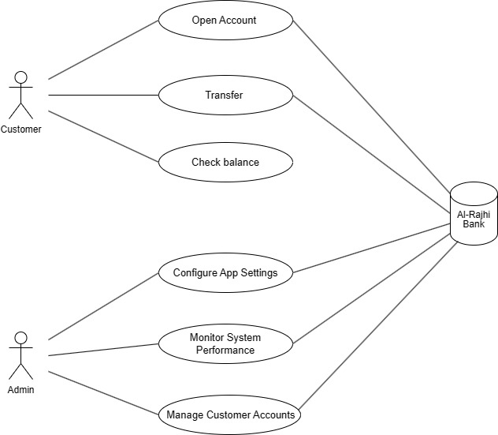
Project Use Case Modelling

Slide 11
Project Use Case Modelling
Actors | Customer and Bank
Description | Explains how to transfer money to beneficiaries or government agencies
Data | Money, a message arrives on the phone with a verification number
Stimulus | The customer wants to transfer his money to another beneficiary or to a government agency
Response | The money was transferred to another beneficiary or to a government agency
Customer | Check Balance Transfer open account
Admin | Configure App Settings Monitor System Performance Manage Customer Accounts
Actors | Customer and Bank
Description | Opening an account for the Customer in Al Rajhi Bank
Data | ID number, phone number, email
Stimulus | The Customer wants to open an account
Response | The money was transferred to another beneficiary or to a government agency

Slide 12
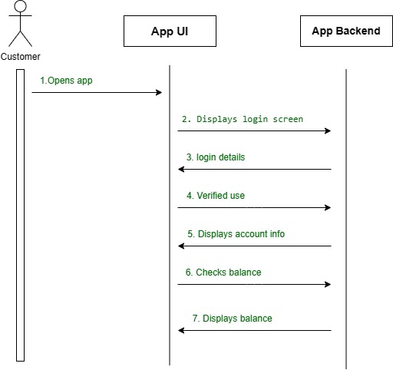
Sequence Diagrams

Slide 13
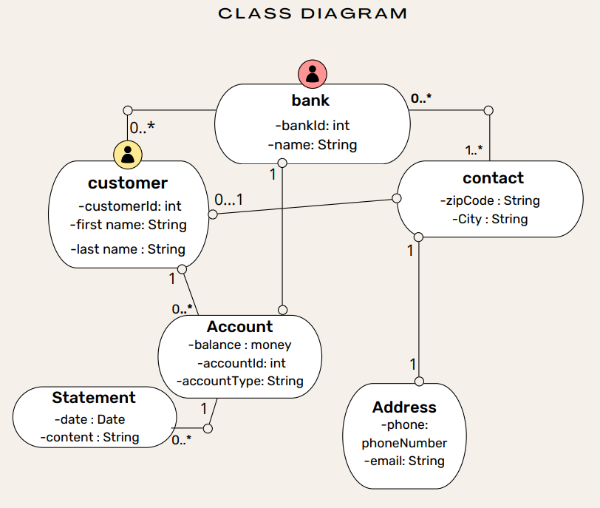
User Interface Design

Slide 14

References
https://www.visual-paradigm.com/guide/uml-unified-modeling-language/what-is-class-diagram/
https://www.visual-paradigm.com/guide/uml-unified-modeling-language/what-is-class-diagram/
https://www.visual-paradigm.com/guide/uml-unified-modeling-language/what-is-class-diagram/

Slide 15

Thank you

